Slide 1
SOLVING A MACHINE LEARNING PROBLEM THROUGH USING SPARK ML PIPELINE
Name:- Antarlin Chanda
Roll No:- C22003

Slide 2
Machine learning is being used everywhere nowadays due to the amount of potential problems its is solving on a day to day basis.We will be looking at one such ml problem where we will try to predict employee attrition in a company.
Introduction
What is attrition?The definition of attrition means wearing down or wasting away, or the natural decline in the number of people working in an organization. An example of attrition is a cliff face eroding due to rain and wind. An example of attrition is one army wearing down another throughout the course of a war.

Slide 3
High attrition is very much harmful as it causes less revenue generation.For example when a new employee joins there is training time and money associated with onboarding and other related expenses.Also productivity is low at initial stages.Now if employees leave too early then many of the above expenses simply goes to waste.For older employees losing them is harmful as they are more productive and accustomed to the work cultures and are thus valuable.So companies must look into attrition with so much caution as lowering it is important for making profits and ensuring smooth company operation.
Problem Relevance and Objective

Slide 4
TOOLS USED
Tools used for the same are Spark ML pipeline, MongoDB,Clevercloud,PySpark and python in Google Colab.

Slide 5
DATA DESCRIPTION
The data is taken from ibm hr analytics attrition dataset.
https://www.kaggle.com/datasets/pavansubhasht/ibm-hr-analytics-attrition-dataset
Dataset set contains 34 predictor variables and 1 target variable(Attrition).
Some features are for example Age,Education,Gender etc
Data is a mixture of both categorical and numerical data.
Output variable was categorical in nature and ours was a classification problem
No missing values were found

Slide 6
PROBLEM SOLUTION STEPS

Slide 7
DATA Extraction from MongoDB through using clevercloud and loading in google colab spark VM
Data EDA and Preprocessing
Data Conversion through using String Indexer,One Hot Encoder,Assembler,
Formation of ML Pipeline
Fitting Our Models
Getting Outputs
Make Conclusions and provide insights

Slide 8
DATA EXTRACTION FROM MONGODB
Loaded json of data file into mongodb using mongocompass software and then used clevercloud hosting platform to connect the mongodb database to our google colab VM spark.

Slide 9
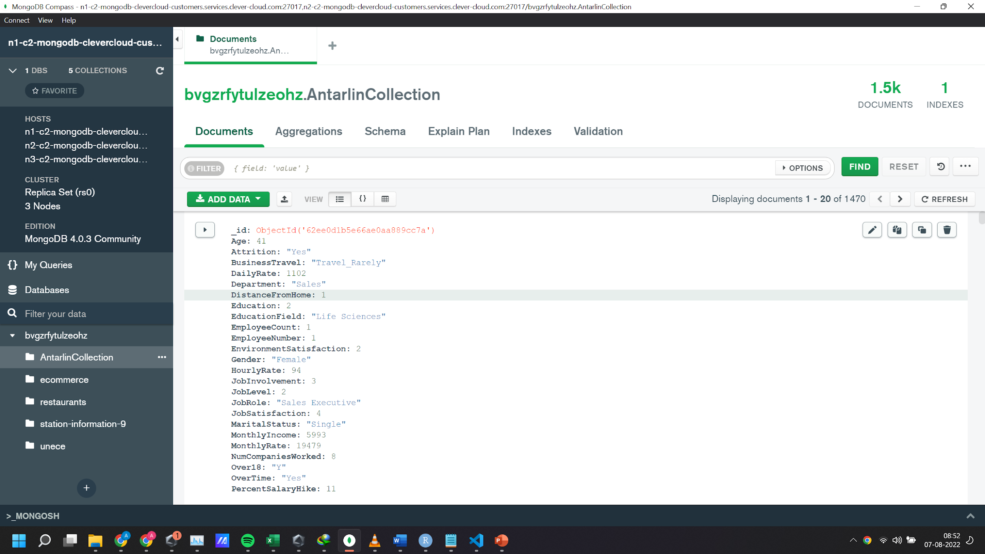
MongoDB Compass Software where we uploaded our json file therough add
data to our database

Slide 10
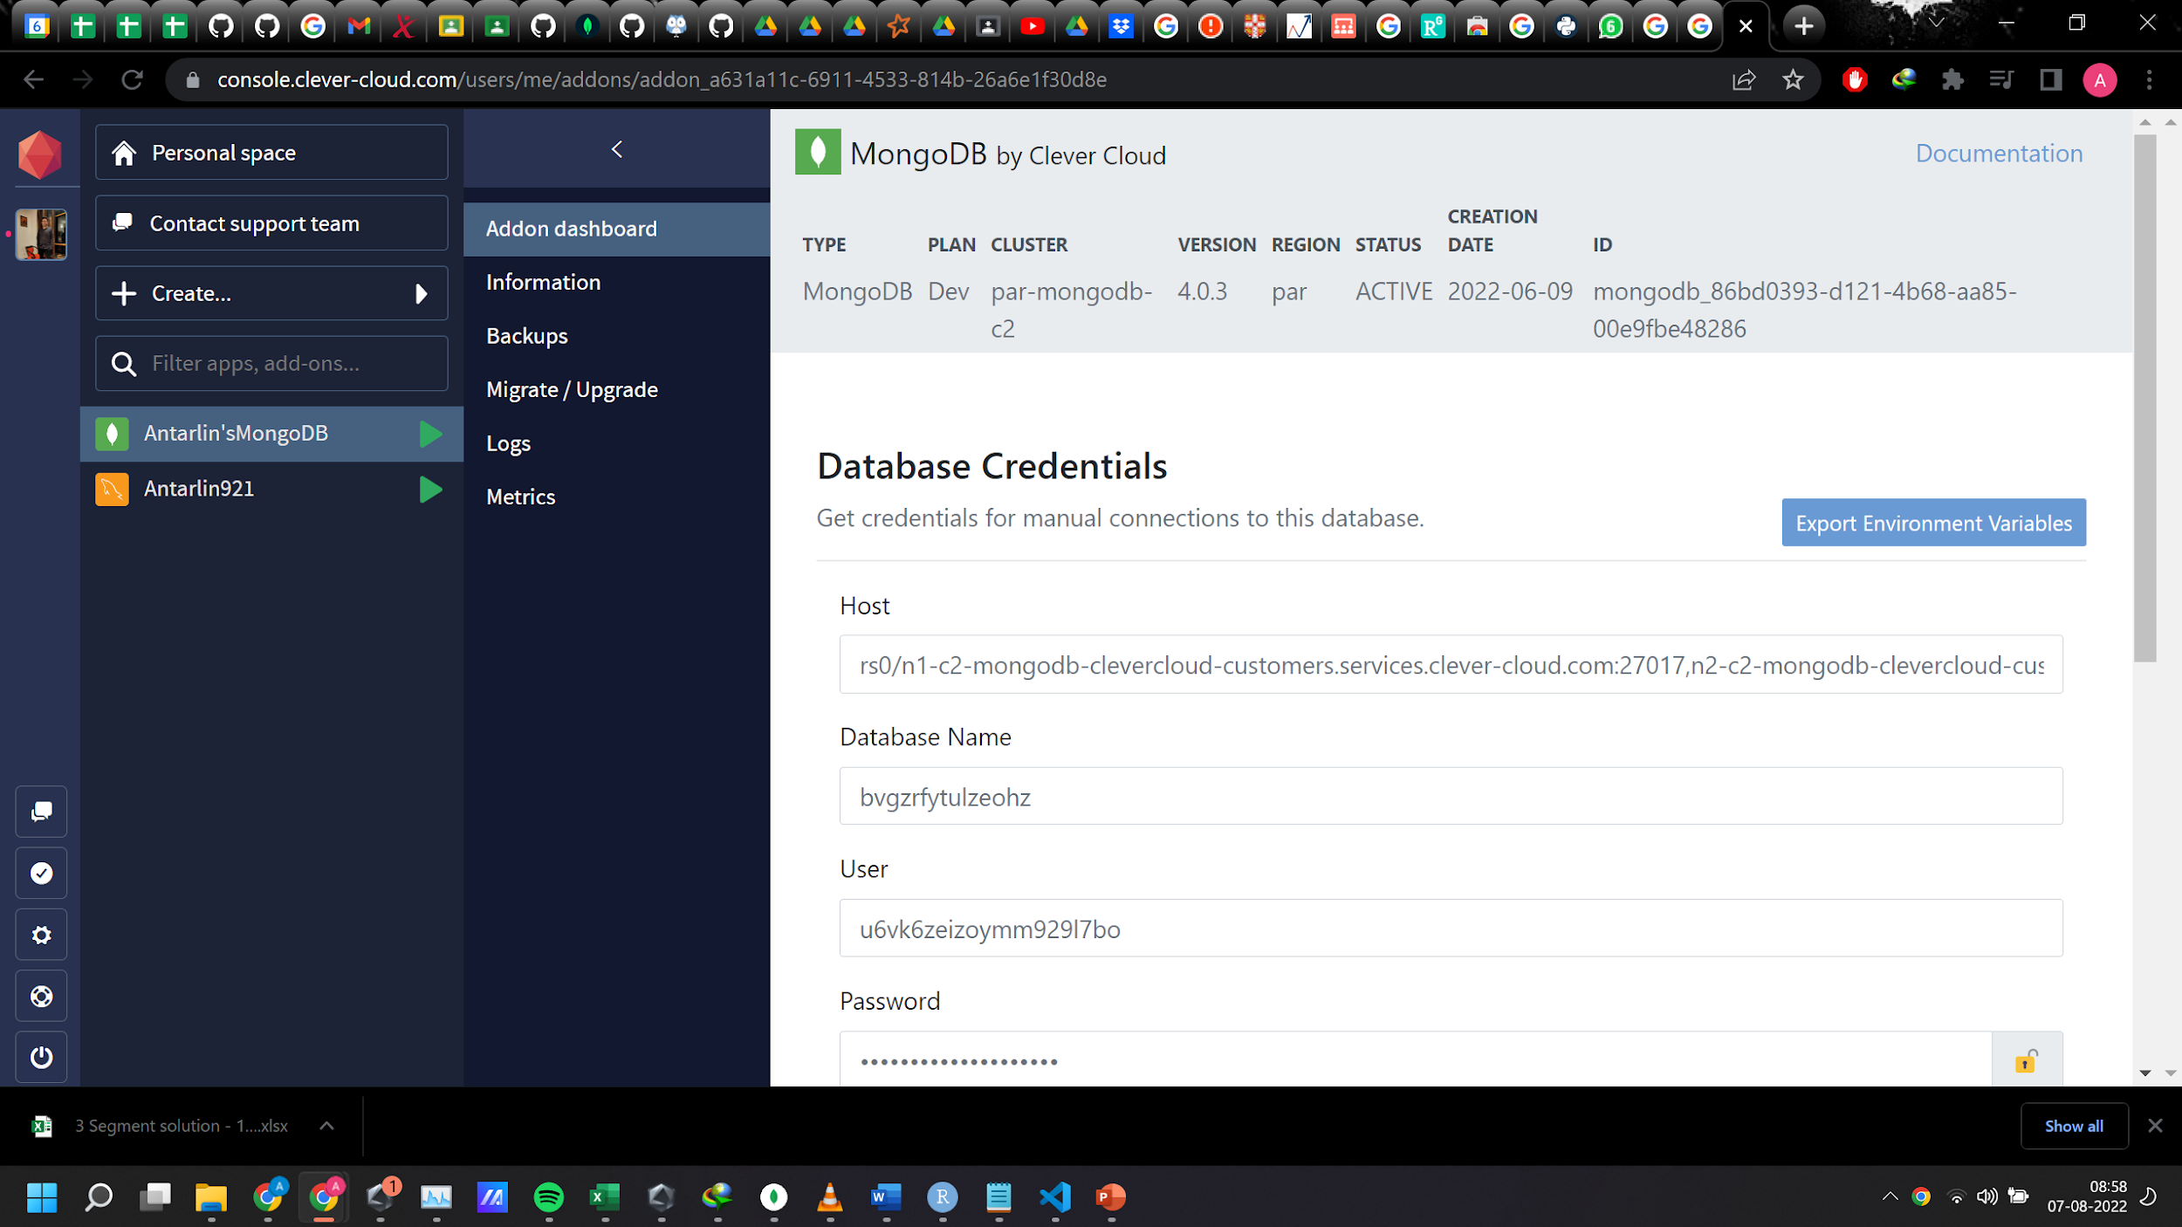
CleverCloud interface

Slide 11
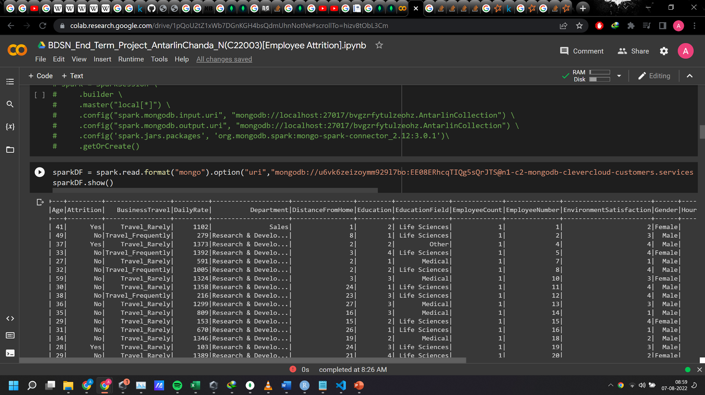
Loading Data from mongodb using clevercloud into colab
VM spark dataframe

Slide 12
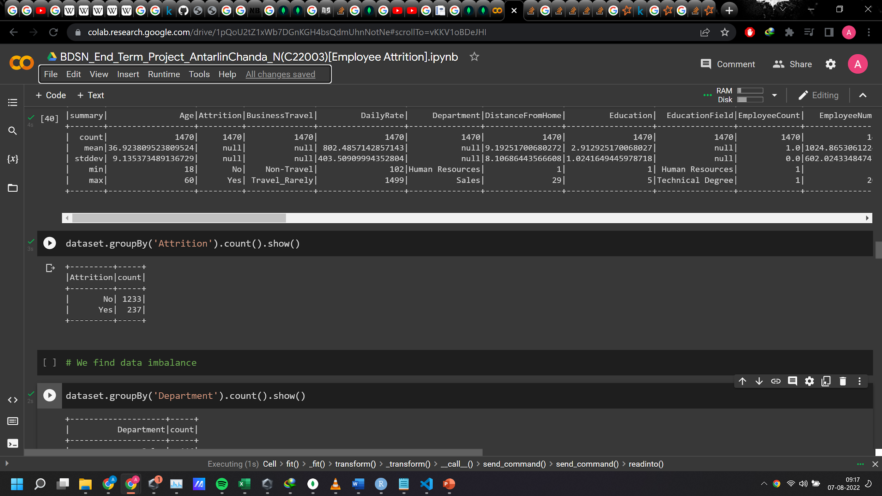
TARGET VARIABLE DISTRIBUTION
Our target variable is Attrition we find data imbalance.

Slide 13
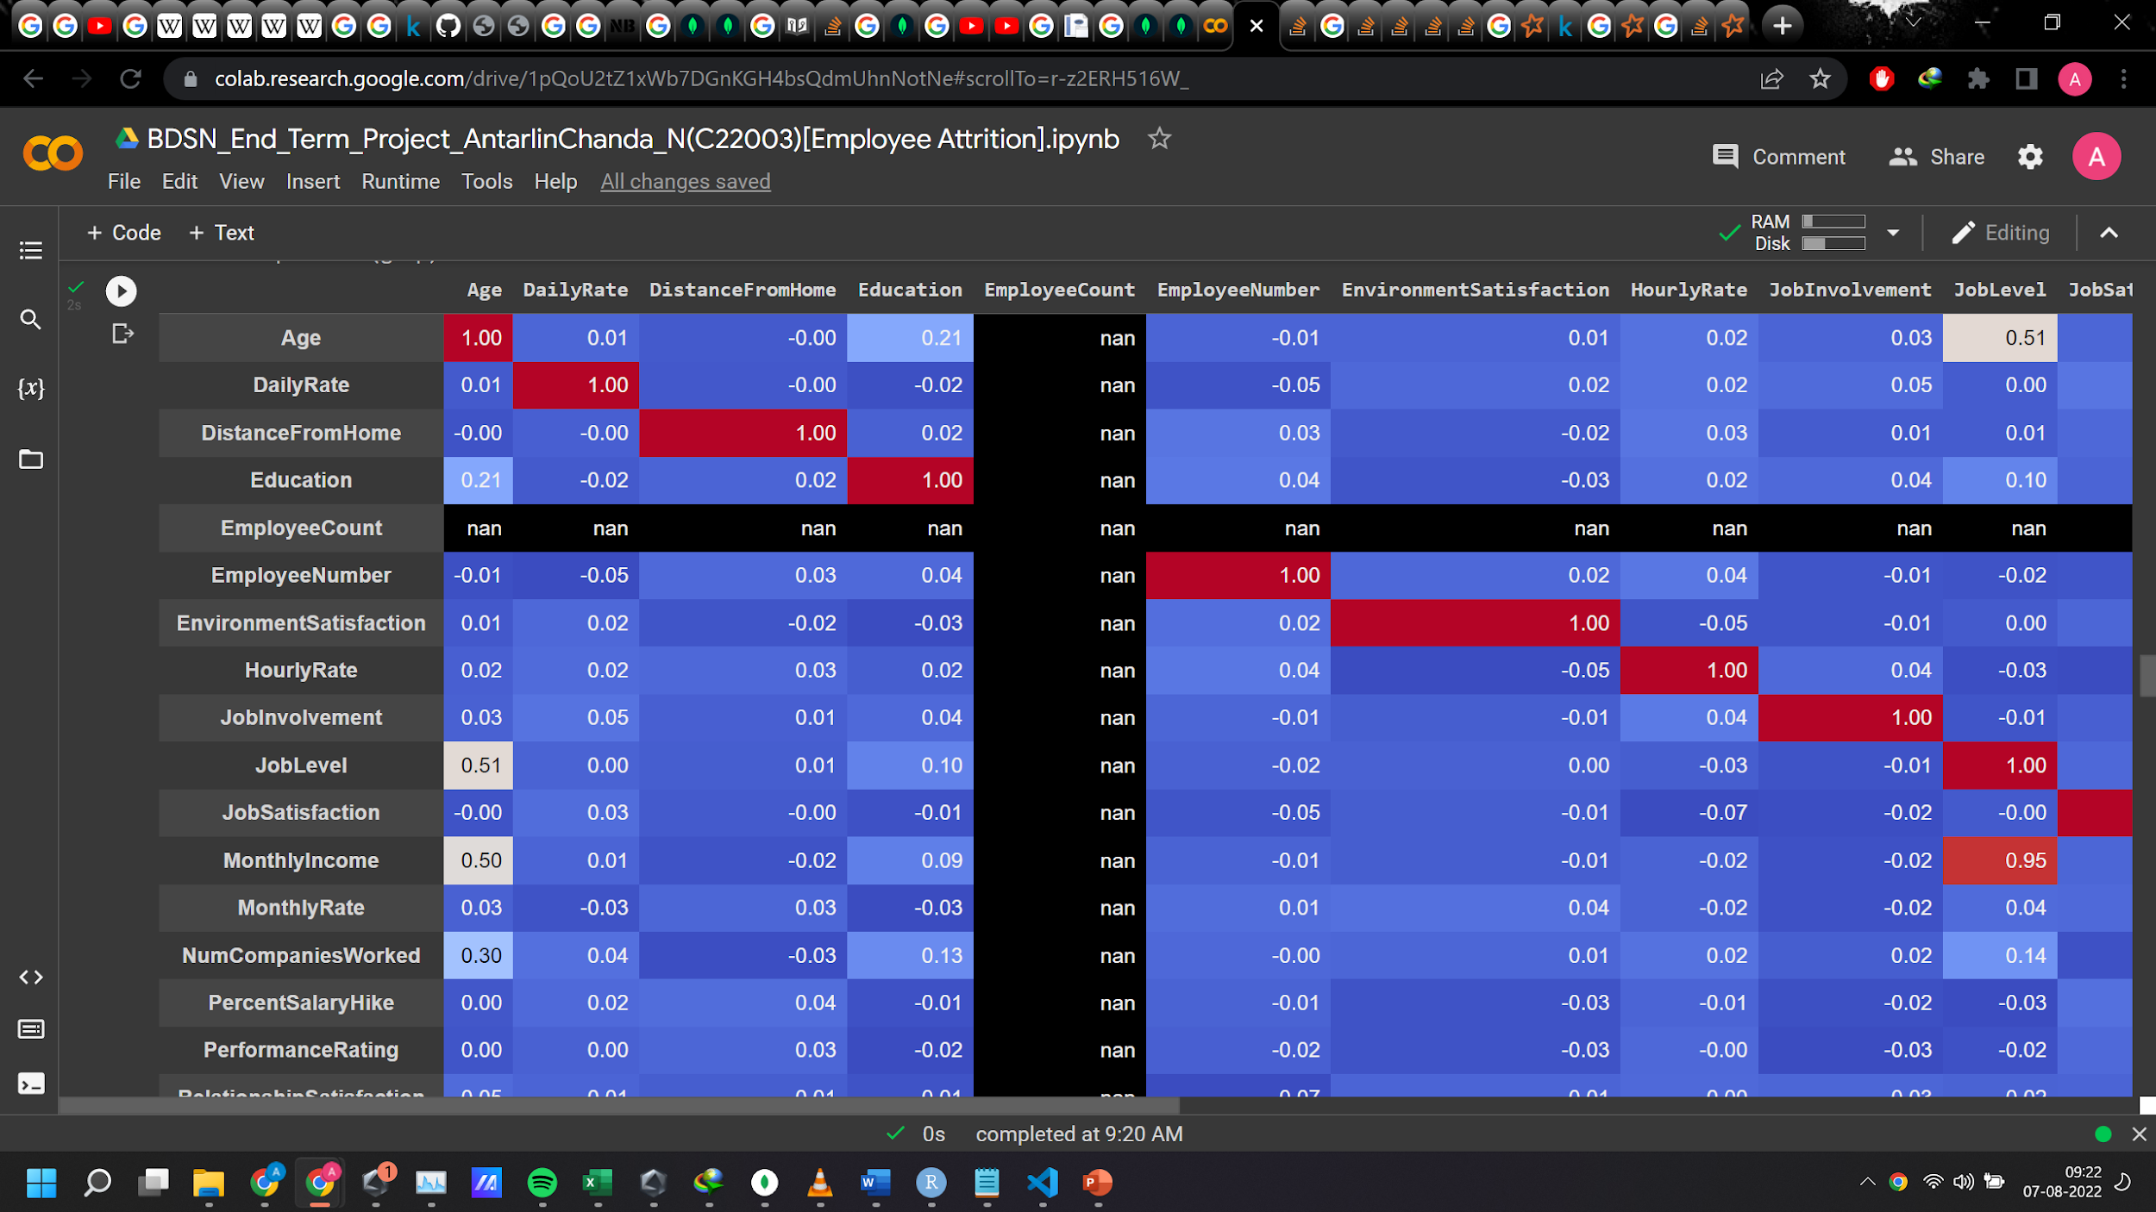
EDA
Describe,Info and other relevant attributes were check.We also visualized the correlation matrix

Slide 14
DATA PREPROCESSING
Missing values check
Irrelevant Coloumns dropped as no variance observed across them('Over18','StandardHours','EmployeeCount’)

Slide 15
DATA PREPARATION FOR MODELLING
We applied 3 important transformers/estimators from the pyspark.ml library before we start to build the model.
After applying them, the data will be ready for model building.
StringIndexer
OneHotEncoder
VectorAssembler

Slide 16
TRANSFORMERS/ESTIMATORS USED
StringIndexer converts a single column to an index column. It simply replaces each category with a number.
“OneHotEncoderEstimator” is used to convert categorical variables into binary SparseVectors.
All features are transformed into a vector using VectorAssembler.

Slide 17
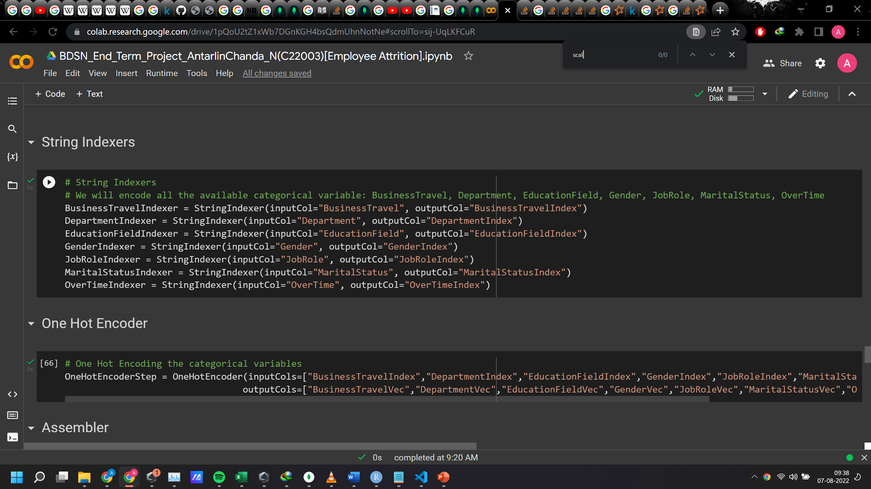

Slide 18
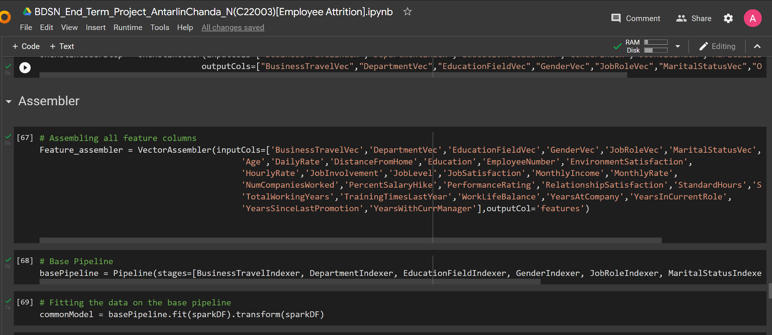

Slide 19
MODEL PIPELINE
We use pipeline to chain multiple Transformers and Estimators together to specify our machine learning workflow. A Pipeline’s stages are specified as an ordered array.
An Easier Way To Build Pipeline
First of all we determine categorical columns. Then, it indexes each categorical column using the StringIndexer. After that, it converts the indexed categories into one-hot encoded variables. The resulting output has the binary vectors appended to the end of each row. Next, we use the VectorAssembler to combine all the feature columns into a single vector column.

Slide 20
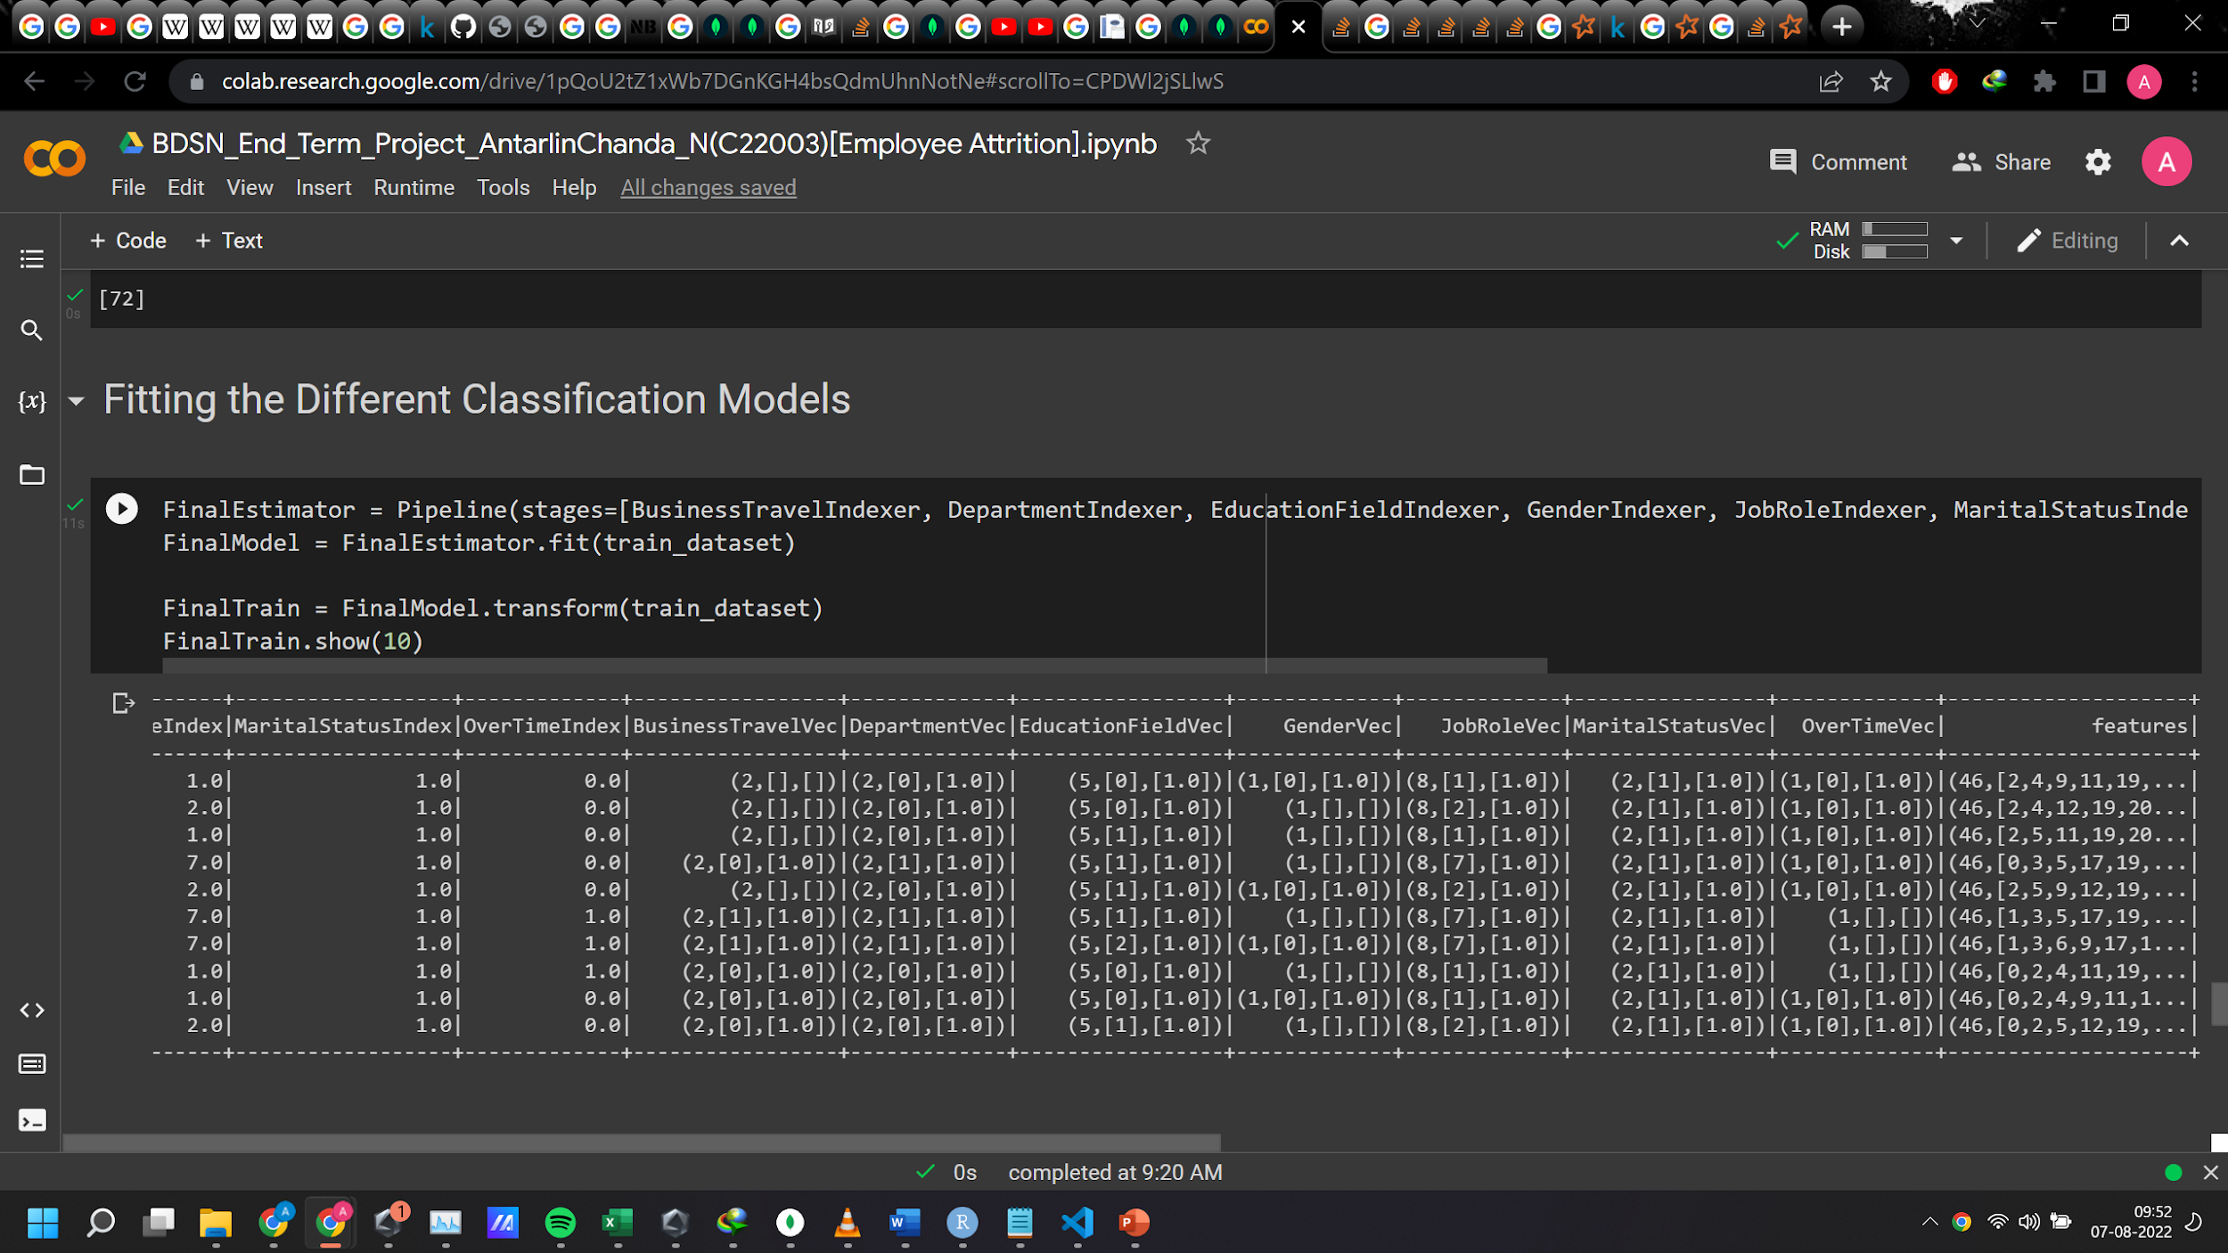
Running the stages as a Pipeline puts the data through all of the feature transformations we described in a single call.Notice how we converted from categorical to encoded to features dataformat in one sigle step.
This is the utility and use of piepelines which makes them so good and useful.Once you have bulit it ,its stable and a rigorous tool for the purpose it was designed for.

Slide 21
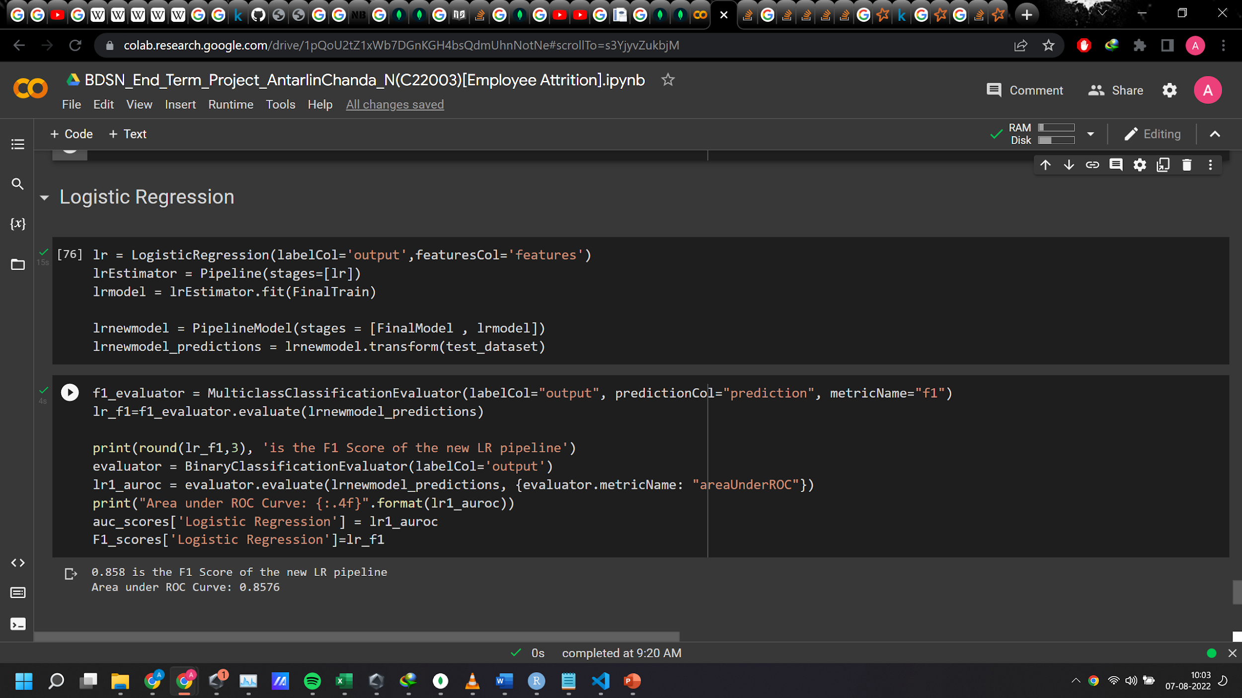
MODELLING
Logistic Regression:-
F1 Score found: 0.858
Area under Roc Curve 0.8576

Slide 22
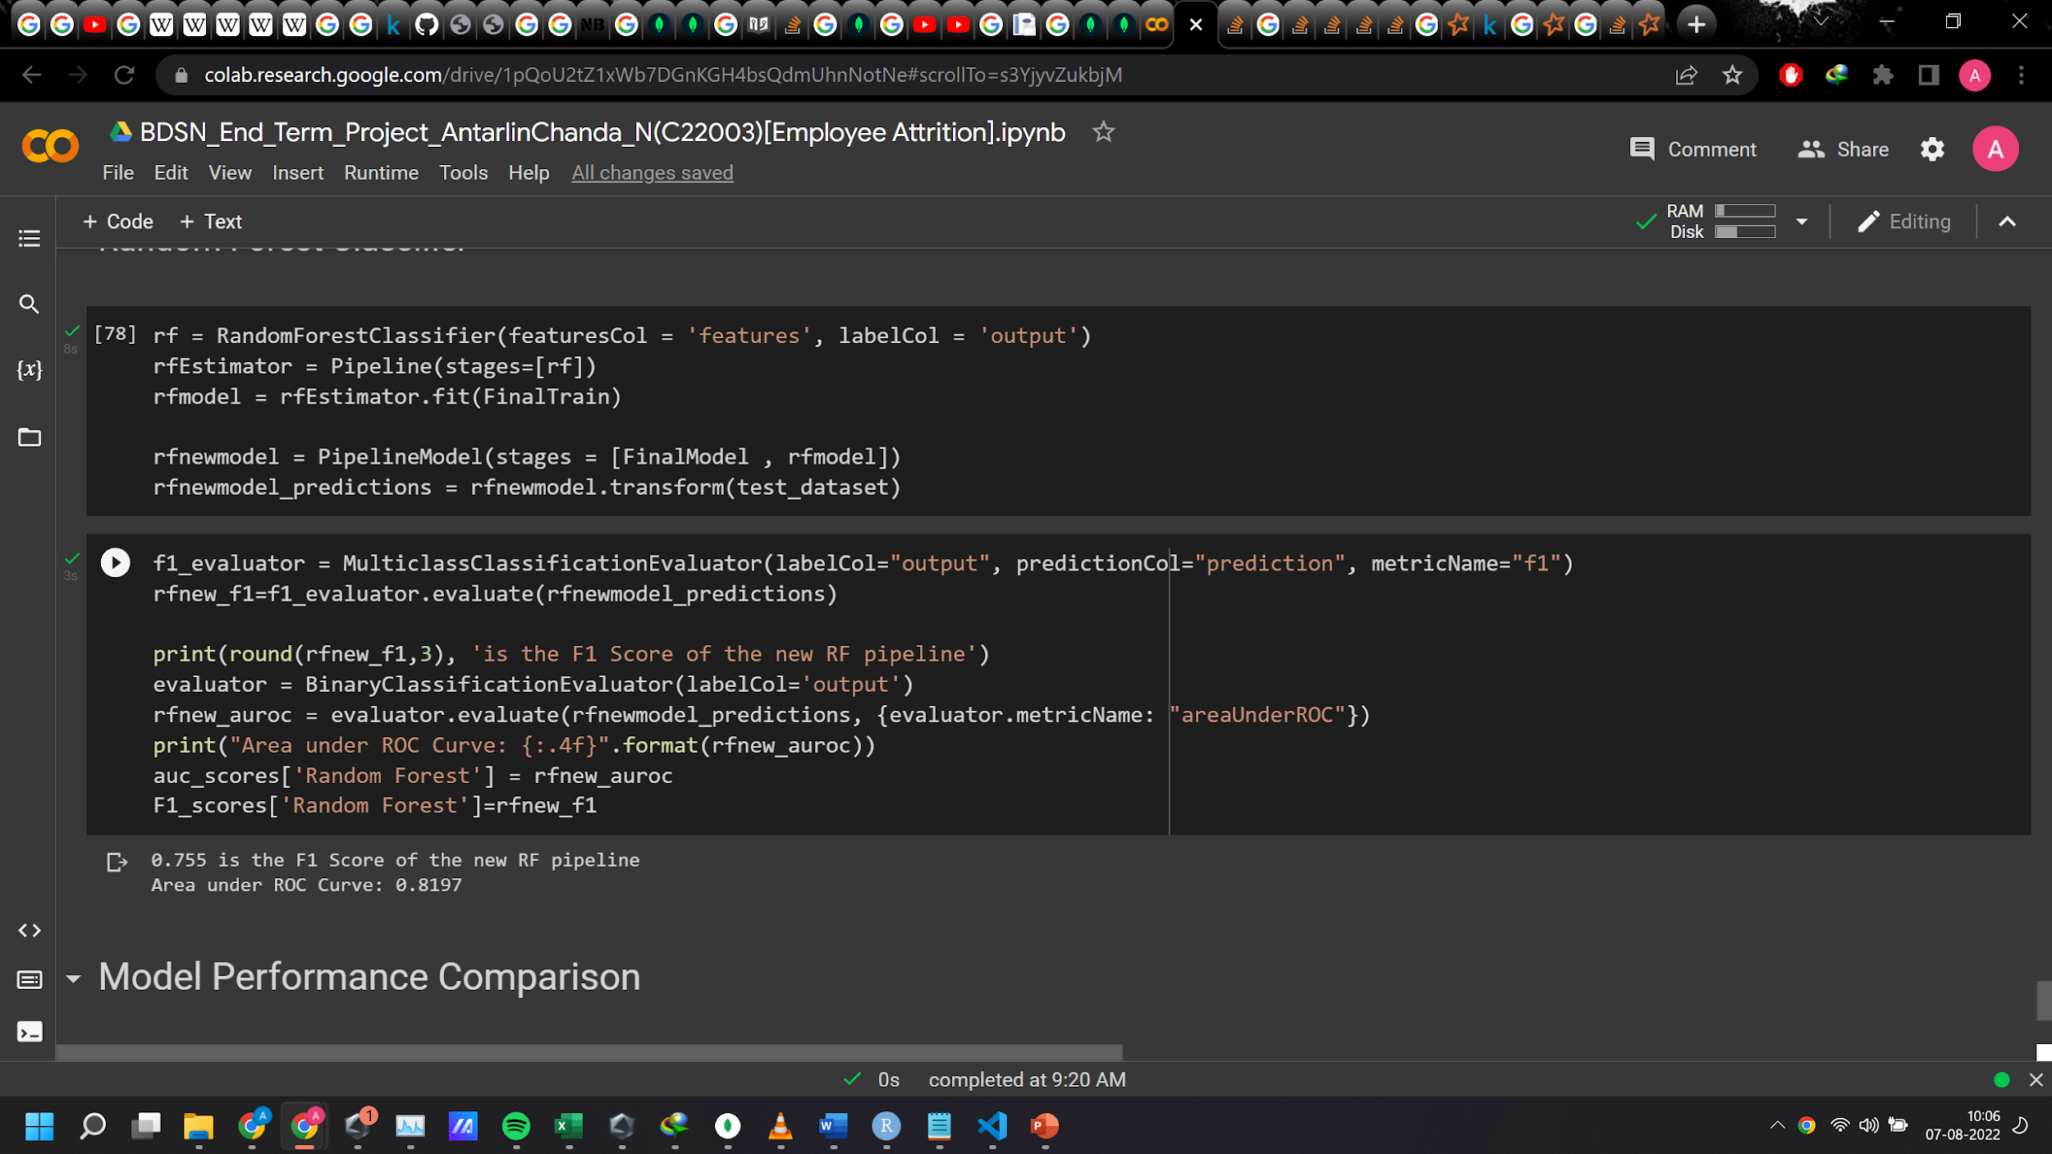
Random Forest
F1 Score found: 0.755
Area under Roc Curve 0.8197

Slide 23
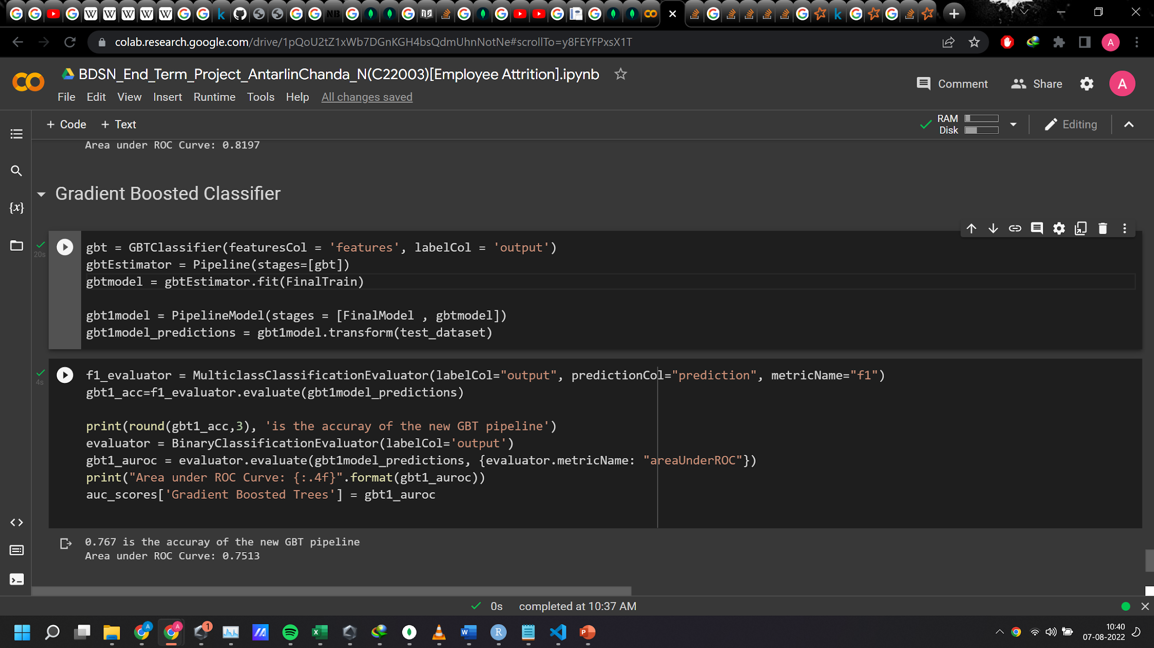
Gradient Boosting Classifier
F1 Score found: 0.767
Area under Roc Curve 0.7513

Slide 24
RESULTS
We see that the model performance are around 80 percent F1 score and AUC ROC.
Logistic Regression Actually outperformed the other more complex non linear models showing the data is linearly seperable but maybe performance of the other algos can be pushed further with hyperparameter tuning.
Also F1 scores are also around this region.So our models are reasonably good at predicting people who are attriting.
Now this model can be used on another new set of employees so that we can determine which people have highest chance to leave and thus take actions so as to address the issue
Like for example workhour flexibility,location flexibility ,more benefit schemes,grievance adressal etc.
So if we take actions on these points we will reduce attrition and this will in long run provide boost to employee satisfaction and increased revenue and profits.

Slide 25
THANK YOU

